Slide 1
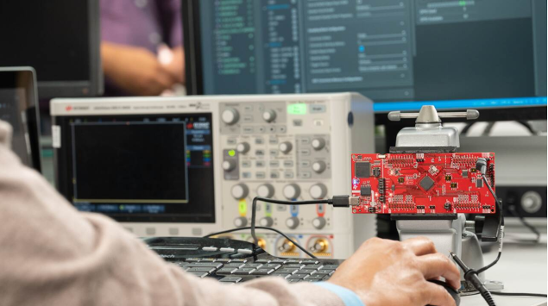
1) Micro-USB Port (Main Port)

Slide 2
1) Power Supply (5V)
The board needs 5V DC
USB provides power from your laptop
No extra adapter needed
👉 Without this → Board will not turn ON

Slide 3
2) Communication (UART Data Transfer)
This is very important for your project.
It:
Sends radar data to your laptop
Receives configuration commands from PC
Creates 2 COM ports in Device Manager
For vital signs:
One COM port sends heart & respiration data
One COM port receives configuration commands
👉 Without this → No data transfer to MATLAB/Python

Slide 4
3) Firmware Flashing
When you upload:
Vital signs demo
Custom firmware
You use this same USB port.
👉 Without this → You cannot program the radar

Slide 5
✅ SOP Mode Switch ⚙️ (Boot Mode Selection)
This is not a cable port, but it is REQUIRED.
📌 Why it is needed:
It decides:
Whether the board runs normally
Or enters flashing mode
For your project:
👉 If SOP is wrong → Board will not start correctly
Situation | SOP Mode
Running Vital Signs Demo | Functional Mode
Uploading new firmware | Flashing Mode

Slide 6
2.) External 5V Power Jack (Optional)
Why it is NOT usually required:
USB power is enough.
Use only if:
USB port cannot supply enough current
You attach extra hardware
For your normal biomedical project → NOT needed

Slide 7
Ports You DO NOT Need
Port | Why Not Needed
60-Pin Expansion | Only for external processor integration
JTAG | Only for low-level debugging
External Antenna Port | Antenna already integrated

Slide 8
